Slide 1

Big Mountain Project

Slide 2
Goal:
The purpose of this data science project is to come up with a pricing model for ski resort tickets in our market segment.
Big Mountain suspects it may not be maximizing its returns, relative to its position in the market.
It also does not have a strong sense of what facilities matter most to visitors, particularly which ones they're most likely to pay more for.
This project aims to build a predictive model for ticket price based on a number of facilities, or properties, boasted by resorts (at the resorts).
This model will be used to provide guidance for Big Mountain's pricing and future facility investment plans.

Slide 3
Problem Statement Worksheet (Hypothesis Formation)
How can Big Mountain Resort use market data from resorts around the country to derive the best value for their ticket price and determine the financial impact of facility changes for the upcoming season?
1
Context
4
Constraints within solution space
Big Mountain Resort is a ski resort located in Montana offering views of Glacier National Park and Flathead National Forest. It’s current pricing strategy has been to charge a premium above the average price of resorts in it’s market segment and they recently increased operating costs by $1,540,000 this season by purchasing a new lift. The business wants to evaluate resort data across the country to generate a data-driven strategy to value their ticket price and evaluate further changes to the facility for the upcoming season.
Developing market analysis with lack of consumer data that illustrated factors that lead to resort selection.
Lacking performance data of tickets sold throughout a season.
5
Stakeholders to provide key insight
Owner
Maintenance director
Hotel Manager
Mountain Manager
2
Criteria for success
Determine the ticket price that will maximize revenue by doing a market analysis of resorts around the country.
3
Scope of solution space
6
Key data sources
This analysis will focus on ticket price and enhancement/cost cutting efforts to the facility.
Physical data of other resorts ski areas and capacity.
Cost data of other resorts around the country.
Performance data of other resorts.
H
D
E
I
P
Notes:
Hypothesis: Create a Hypothesis with an emphasis on SMART principles. (S – Specific, M – Measurable, A – Achievable, R – Realistic, T – Timebound). If you cannot do this, you do not have a good grasp on the business problem.
Context: With context, we have clearly identified the problem at hand and have elucidated on how our initiative may solve this problem, alongside the commercial implications this will have on the business.
Criteria for Success: Clearly defining the criteria for success ensures that the scope of your work is clearly defined and understood. Otherwise, if this isn’t defined – your work will never end which will result in mismatched expectations.
Scope of Solution Space: Scoping out the solution space ensures that the business initiative is SPECIFIC for a certain segment or area. This prevents solutions that have been developed being scaled and applied for all other business units that the solution may not be responsible or scalable for.
Constraints within Solution Space: Looking forward, what are the foreseeable problems we are likely to encounter? Could this be stakeholder resistance? Could this be we don’t have access to the right data?
Stakeholders to provide key insight: Who are the people I need to speak to, to get the answers I need for my data analysis?
What key data sources are required?
Based off my discussions with the key stakeholders – can we clearly list out all the data sources we need so we can make a highly targeted request as opposed to a scatter-gun approach where we ask for a bit of everything?

Slide 4
Recommendations for Price:
Currently, Big Mountain resort charges $81 per ticket. According to our modelling, Big Mountain could support a ticket increase anywhere from $4.91 to $15.32 leading to a ticket price of $85.91 to $96.32 respectively. These price increases would lead to a revenue increase of $8,592,500 or $26,810,000 respectively.
I would not suggest raising the price by $15 initially but I would say that the model implicates that there is room for growth in the price.
The reason for this price optimization is that Big Mountain leads the market in the most important facility metrics that lead to increased ticket price such as Vertical Drop, Snow Making area, Total number of chairs, Fast Quads, Runs, Longest Run, and Skiable Terrain Area. The following charts explain this:

Slide 5
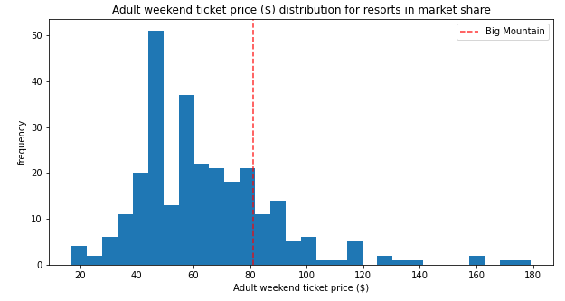
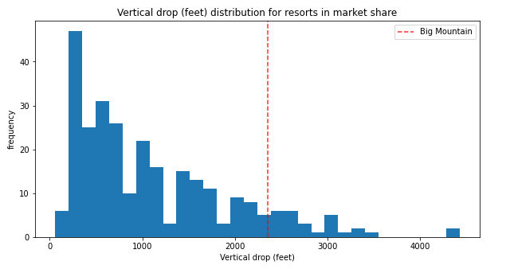
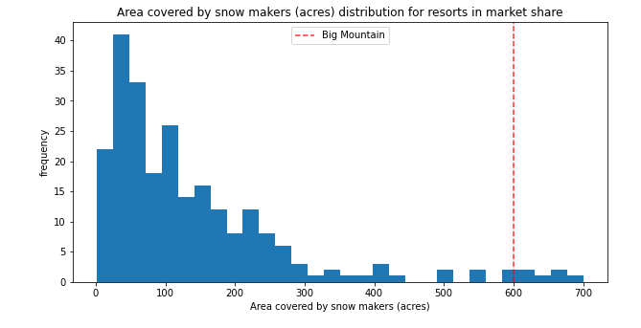
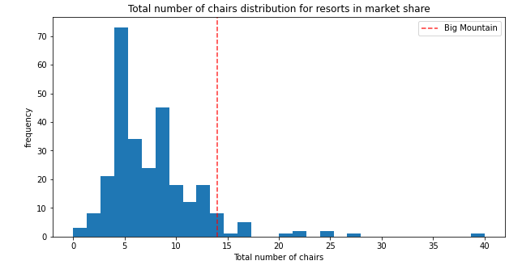

Slide 6
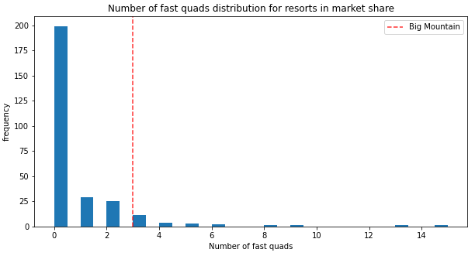
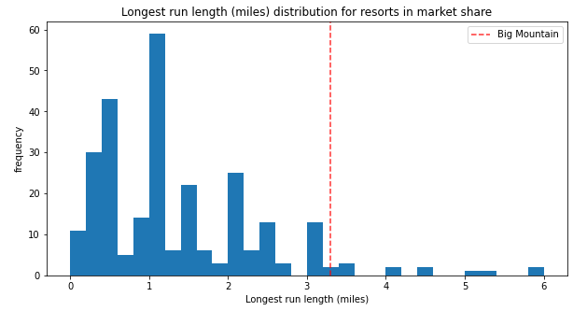
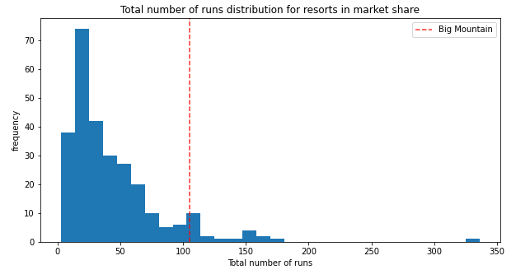
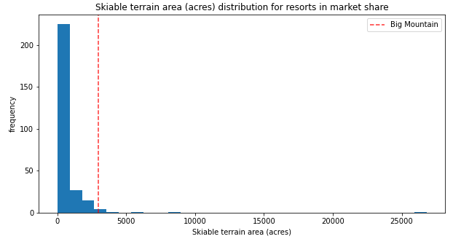

Slide 7
Recommendations for Enhancements:
Regarding recent renovations, the new chairlift should allow the business to charge $0.29 more per ticket leading to a revenue gain of $507,246 according to the model.
As for future improvements, I would advise against Scenario 4 and Scenario 3 as they do not provide incremental value.
I would advise looking into Scenario 2 as that will increase support for a ticket price by $1.99 for a total increase of $3,474,638.
If Big Mountain were to pursue run closures, I would limit it to one at first as that had little effect on the modeled ticket price. I would not close more than 5 runs as there is a significant drop off in price with that change. I would suggest closing a few at a time and see how it affects crowds and demand. The effect on run closures is shown in the following slide:

Slide 8
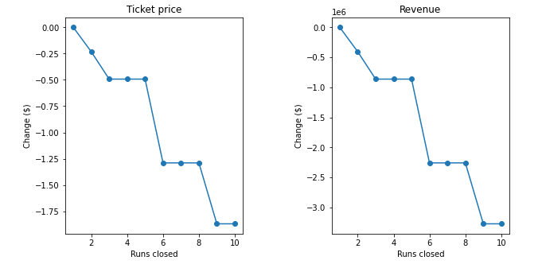
Runs Closed vs Ticket Price and Revenue

Slide 9
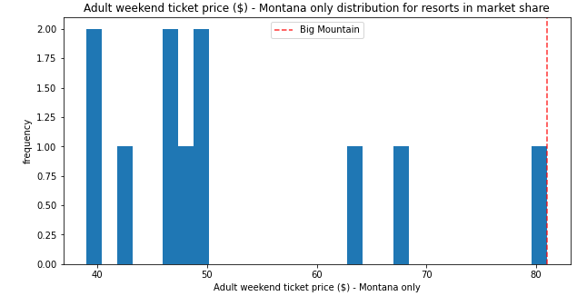
Further Work
A reason to be skeptical of the model is the lack of data in the model. We did not have market attendance data to determine demand levels by state. Big Mountain leads all resorts in ticket price in Montana and this would grow even further with a price increase.
We also lacked pricing data for upgrades which limited the scope of this analysis. Cost information for each of the scenarios would be helpful in providing additional business insight.
Although Big Mountain was a relatively expensive compared to other resorts, the modeled price was so much higher because of Big Mountains superiority in several metrics that proved to be most valuable throughout the market.

